Slide 1
Recurrent Neural Networks
11-785 / Fall 2018 / Recitation 7
Raphaël Olivier

Slide 2
Recap : RNNs are magic
They have infinite memory
They handle all kinds of series
They’re the basis of recent NLP : Translation, speech recognition, speech synthesis, etc.
Have you noticed how Google Translate suddenly became good in November 2016 ?

Slide 3
Recap : RNNs are hard to train
They suffer from :
Saturation
Vanishing/exploding gradients
Complex loss surfaces with tons of bad local minima
They don’t like usual dropout
...
LSTMs/GRUs address some of these issues, but they’re not perfect.
When you use RNNs, you have to try a lot, and look up for solutions in papers.

Slide 4
News : RNNs are hard to implement
Or at least a bit harder than other networks.
That’s what this recitation is for.
Today we’ll create a language model, a simple example of task that uses RNNs.
Make sure you have the notebook within reach.

Slide 5
Plan for today
Language models (HW3p1)
RNNs in Pytorch
Train a RNN
Generation with a RNN
Variable length inputs

Slide 6
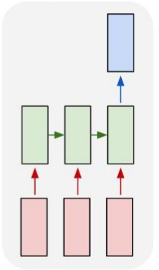
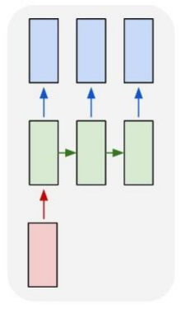
Sequence-based tasks
Many to one One to many
Ex : text classification Ex : sentence generation

Slide 7
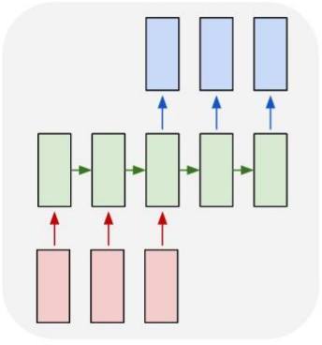
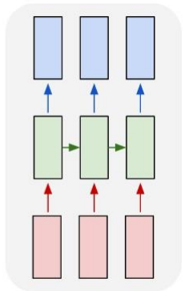
Sequence-based tasks
Many to many Many to many
Ex : machine translation Ex : POS tagging

Slide 8
Language models
Goal : predict the “probability of a sentence” P(E)
i.e. how likely it is to be an actual sentence.
Useful as a sub-task in many contexts. Ex : fluency assessment in machine translation
Building a language model is an unsupervised task…. and also a many-to-many one.

Slide 9
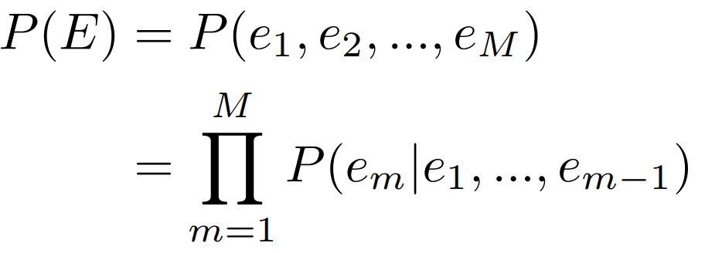


Language models
We now have a sequence to predict :
are the inputs
are the outputs
And we can train with cross-entropy !

Slide 10
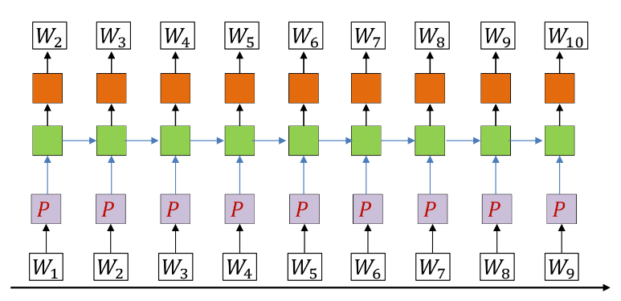
Recurrent language models

Slide 11
Without infinite memory ?
Non-recurrent architectures make the n-gram assumption to be able to use finite memory :
Ex n=3 :
→ Non-neural count-based models, MLP with finite window, etc.
Recurrent networks have infinite memory so they don’t need that assumption.

Slide 12
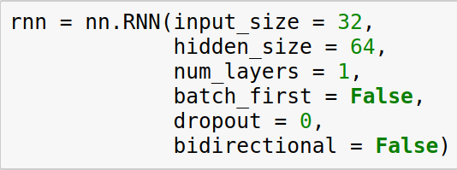
RNN modules in pytorch
num_layers is the number of stacked (vertical) layers
dropout is the dropout between stacked layers
The .forward() method takes an input of size
seq_length x batch_size x input_size
and an optional initial hidden state (defaults to 0) of size
num_layers x batch_size x hidden_size. It returns an output of same size and the final hidden state.

Slide 13
RNN modules in pytorch
Important : the outputs are exactly the hidden states of the final layer. Hence if the model returns y,h :
y[-1] == h[-1]
Similar classes for LSTM and GRU, but for LSTM, h is a tuple (hidden_state, memory_cell)

Slide 14

RNN modules in pytorch
Sometimes you want to have more control between the stacked layers and the time steps (for example to access the intermediate hidden states).
For that you have the RNNCell module.
It takes an input of size batch_size x input_size and a hidden state, and returns the next hidden state.

Slide 15

Other layers in a LM
After the RNN module, you stack a linear layer of size
hidden_size x vocabulary_size
Before it, you need a word projection aka an embedding.
Takes a LongTensor of arbitrary shape.

Slide 16
Training a LM
Now you need batches to feed your model. Initially, you only have one big text.
The simplest way :
Fix a sequence length L
Concatenate all your words into one big (long) tensor of size N
Divide it into N // L tensors of size L
These are your elements.
Even if you train on a fixed size, the network should learn to generate text of arbitrary length.

Slide 17
Evaluate your model
To evaluate how good your model is, you usually feed it with actual text from the (validation) set and look at :
The loss per word : l = loss/n_words
The perplexity : p = exp(l)
It quantifies how well your model predicts that sentence.
Let’s try all that out !

Slide 18
Prediction
Language models are usually used in other downstream tasks. But you can use them to generate some text given a beginning.
As in MLPs for classification, you want to predict the most likely element from your output distribution
Generate one word is straightforward : you feed your text, get the last output (probability distribution on the vocabulary) and predict its argmax.

Slide 19
Generation
To generate N words, you have N*vocabulary_size possible sequences. Recall that
To know each sentence’s probability you’d need to feed all (N-1)-length beginnings → (N-1) * vocabulary_size forward passes !
Unfeasible.
→ Need another way to get the most likely sequence, or at least a very likely one.

Slide 20
Greedy search
Idea : if at each step you take the most likely word, the overall sentence should be likely too.
It’s called greedy search :
At step t, select the most likely word from your distribution over the vocabulary
Use it as input at step t+1
It’s the most simple inference method (and also not the best).
Let’s try it out !

Slide 21
Random search
At step t, sample a word from your distribution over the vocabulary
Use it as input at step t+1
Not obviously better than greedy search but you can apply it several times, get different results, and take the likeliest one.

Slide 22
Beam search
Same as greedy search but you keep the n best words at each step rather than the one best. n is the beam size.
You store and update a list of hypothesis.
When increasing n, you get rather close from the most likely sentence.
Most research papers’ favorite, but a bit trickier to implement.

Slide 23
And that’s all with RNNs
That was easy, no ?

Slide 24
And that’s all with RNNs
That was easy, no ?
.
.
.
.
.
.
… I wish.

Slide 25
And that’s all with RNNs
That was easy, no ?
.
.
.
.
.
.
… I wish.
Let’s go back a few slides.

Slide 26
Training a LM
Now you need batches to feed your model. Initially, you only have one big text.
The simplest way :
Fix a sequence length L
Concatenate all your words into one big (long) tensor of size N
Divide it into N // L tensors of size L
These are your elements.
Even if you train on a fixed size, the network should learn to generate text of arbitrary length.

Slide 27
Training a LM
Now you need batches to feed your model. Initially, you only have one big text.
The simplest way :
Fix a sequence length L
Concatenate all your words into one big (long) tensor of size N
Divide it into N // L tensors of size L
These are your elements.
Even if you train on a fixed size, the network should learn to generate text of arbitrary length.

Slide 28
Limits of fixed-length inputs
For language models trained on one large set, creating batches is rather easy.
For language models trained on several large texts (ex: WSJ articles), you can get fixed-length sequences from separate texts too.
But for supervised NLP tasks, that’s never how it works.

Slide 29
Limits of fixed-length inputs
In Machine Translation, Speech recognition,etc. you have pairs of sequences.
ex : I like apples → J’aime les pommes
You need to keep these sequences as is to learn something.
We’re not dealing with any of these specific applications today but to learn RNNs you need to learn how to deal with variable length inputs.
In this recitation, we’ll stick with language models anyway.

Slide 30
Variable-length inputs
Your dataset is now a list of N sequences of different lengths.
A tensor has fixed dimensions.
How do you feed that in batches to your RNN ?

Slide 31
Variable-length inputs
Idea #1
Use batches of size 1.
Advantages : the simplest, and you can still do minibatch optimization by accumulating the gradients over several examples
Problems : It’s really, really slow.
Conclusion : you may start with that for your prototype, but do better when you begin actual training.

Slide 32
Variable-length inputs
Idea #2
Look for sequences of same size and do batches with them
Advantages : Normally fast, not too complex
Problems : Usually you can’t do it : in many applications pairs of sequences have different lengths, and finding many several pairs with same length elements is unreasonable.
Conclusion : if you can, consider doing it.

Slide 33
Variable-length inputs
Idea #3
Look for sequences of close sizes and pad
Advantages : You can find them
Problems : Usually no “natural” way to pad, so your loss will be noisy
Conclusion : don’t do it

Slide 34
Variable-length inputs
Idea #4
Pad and remove noisy elements before computing the loss (ex: with a mask)
Advantages : Simultaneously quite fast, doable, and Pytorch provides a pad_sequence method to help you.
Problems : You still lose time applying the RNN on zeros. With just one big sequence you may get an unexpected CUDA error. Implementation prone to bugs, hard to track and debug.
Conclusion : one of the recommended methods, but be careful.

Slide 35
Variable-length inputs
Idea #5
Build something up with several tensors for different time steps
Advantages : Faster than all of the previous ones
Problems : If you can implement that without bugs and mistakes, honestly you’re a god.
Conclusion : don’t. Unless….

Slide 36
Variable-length inputs
Idea #5b
Use packed sequences (it’s idea #5 but some gods at facebook did most of the godly work for you)
Advantages : Doable and the fastest. RNN modules are optimized for it. Pytorch provides methods to help you.
Problems : At some point you pad, so unexpected CUDA errors can still happen. Harder to implement and debug than #4 because of sorting. Network has to be changed.
Conclusion : recommended, but be extra careful.

Slide 37
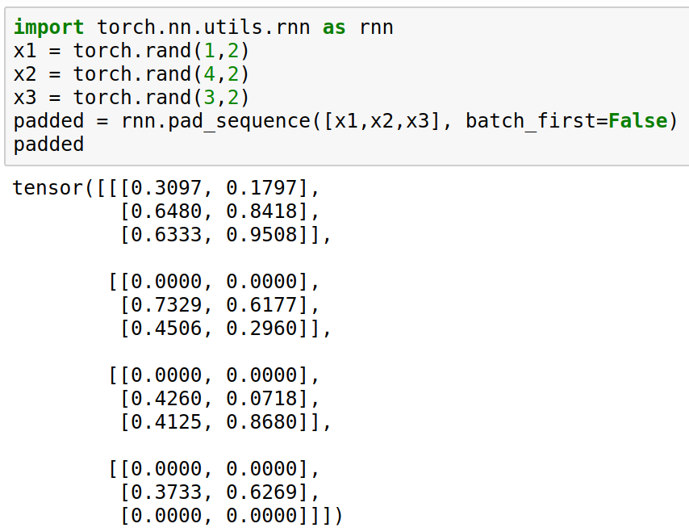
Pad and pack sequences

Slide 38
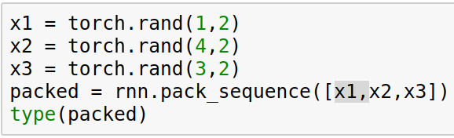
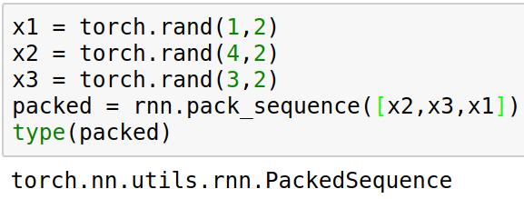
Pad and pack sequences

Slide 39
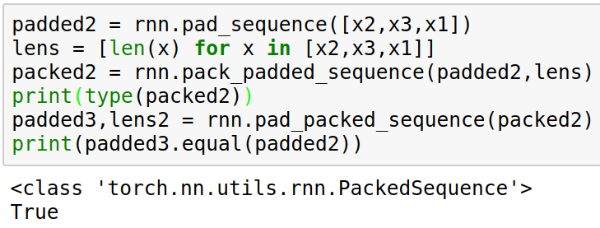
Pad and pack sequences
You can go from padded to packed and packed to padded, but need to track the lengths

Slide 40
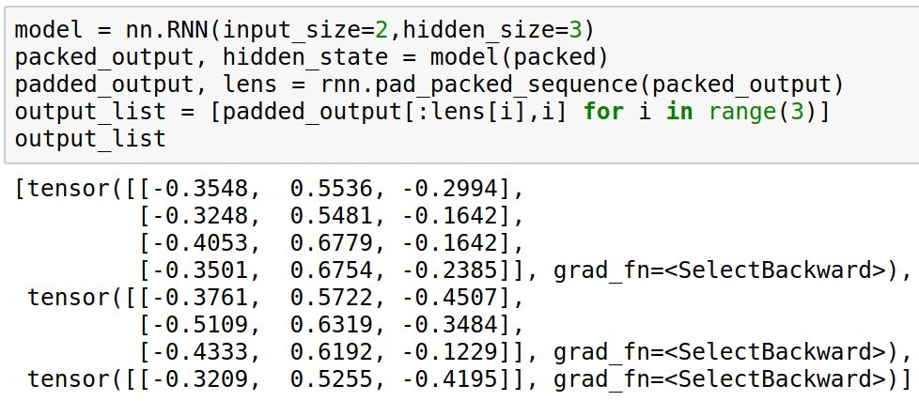
Packed sequences and RNNs
A PackedSequence can be fed into RNN modules, but nothing else.
Packed sequences are on the same device as the padded sequence.
Let’s try this out in a language model !

Slide 41
Next
Sequence-to-sequence with RNNs :
CTC (HW3p2) (Rec. 8)
Encoder-decoder and attention (HW4) (Rec. 9)
Questions ?

